Slide 1
OceanSITES data Incentives for participation: Data citation & data services
Justin Buck (juck@bodc.ac.uk)

Slide 2
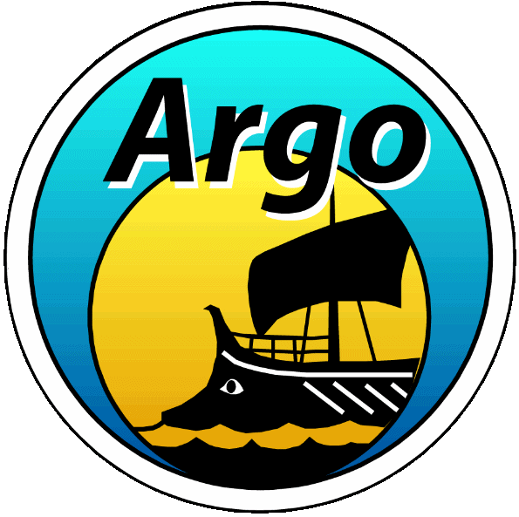
Argo and DOIs
Justin Buck (BODC), Thomas Loubrieu (Ifremer), Fred Merceur (Ifremer), Ken Casey (NOAA), Megan Scanderbeg (Scripps)

Slide 3
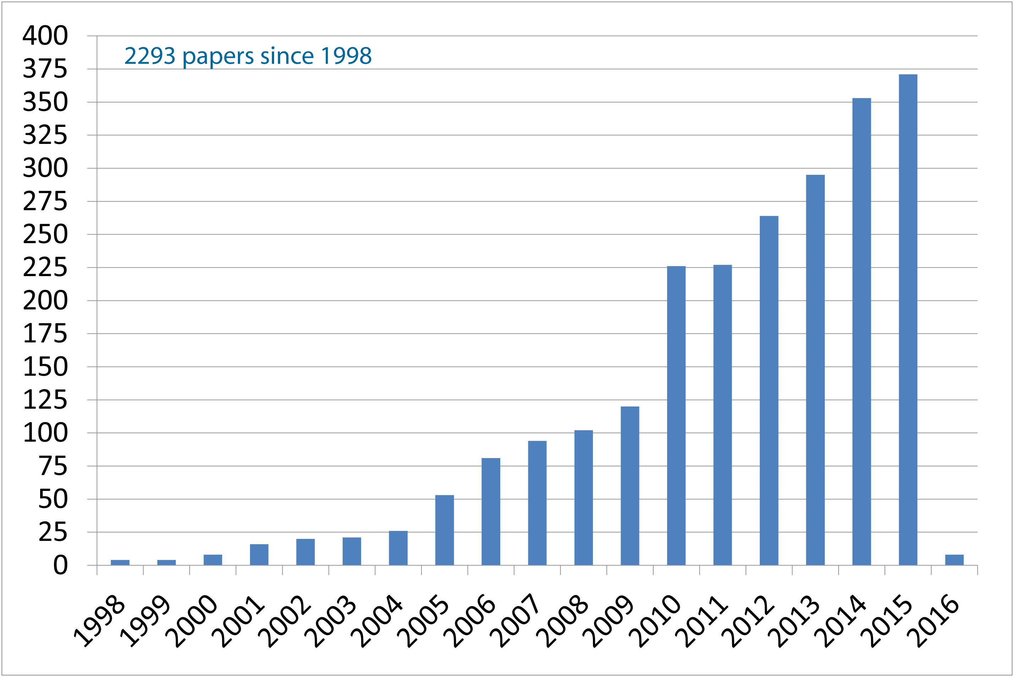
How to cite Argo data at a given point in time?
Can we do this with a single identifier?

Slide 4
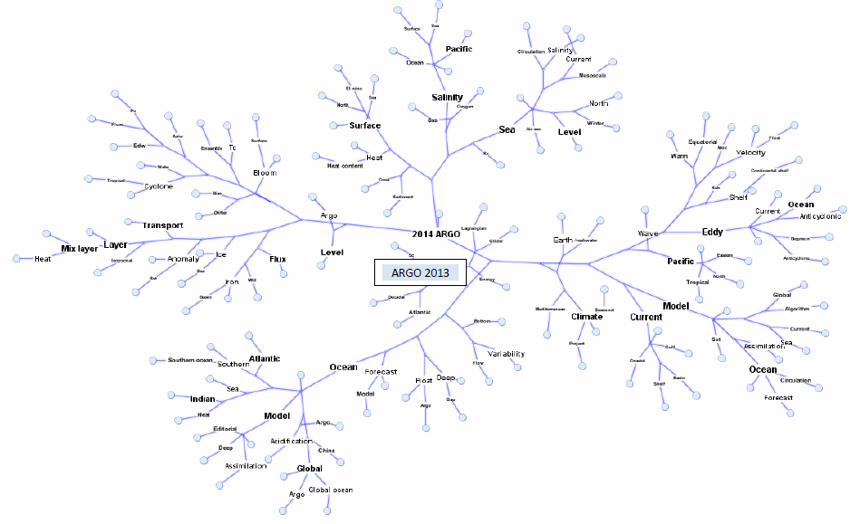
Analysis of citations 2013
http://archimer.ifremer.fr/doc/00191/30237/

Slide 5
Introduction
Push from publishers and scientists for data citation:
Publishers want to link journal articles to the data
Scientists want credit for data set creation and usage
Adopted approach for Argo is to use:
Digital Object Identifiers (DOI)
In particular DataCite DOIs as defined in:
http://schema.datacite.org/meta/kernel-3/doc/DataCite-MetadataKernel_v3.0.pdf
This enables reproducible research and ensures trust in scientific research arising from Argo data (see chapter by Adam Leadbetter in Collaborative Knowledge in Scientific Research Networks. DOI: 10.4018/978-1-4666-6567-5)

Slide 6
Data publication terminology
0. Serving of datasets

Slide 7
1. Dataset citation
0. Serving of datasets

Slide 8
2. “P”ublication of datasets
1. Dataset citation
0. Serving of datasets

Slide 9
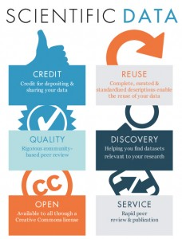
2. “P”ublication of datasets

Slide 10
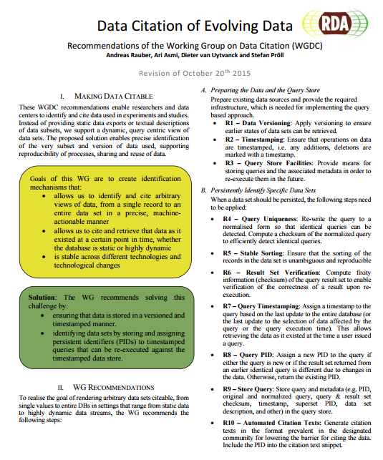
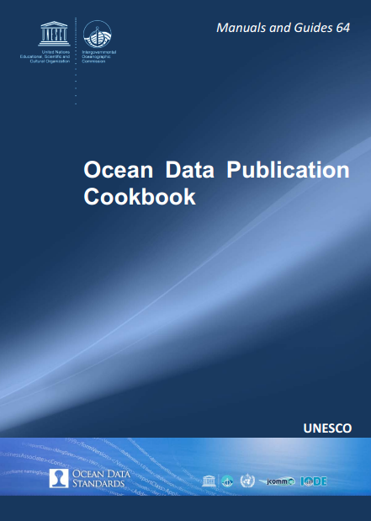
How to assign DOIs
http://www.iode.org/index.php?option=com_oe&task=viewDocumentRecord&docID=10574
https://rd-alliance.org/system/files/RDA-DC-Recommendations_151020.pdf

Slide 11
A single DOI for Argo
Culmination of 5 years persistence came to fruition a month ago!
Minted at Ifremer:
http://www.seanoe.org/data/00311/42182/

Slide 12
Current work - Tracking of citations
Need to be able to perform cited reference searches on data DOIs to find citations in literature.
CrossRef vs. DataCite
Scientific publications predominantly use CrossRef DOIs
Data predominantly us DataCite DOIs
On going to work to build link between CrossRef and DataCite
Data citation approaches
Data DOIs cited in main body of papers -> search implications
Data paper DOIs cited in references -> additional publication

Slide 13
Data standards and integration; Sensor Web Enablement and Linked Data

Slide 14
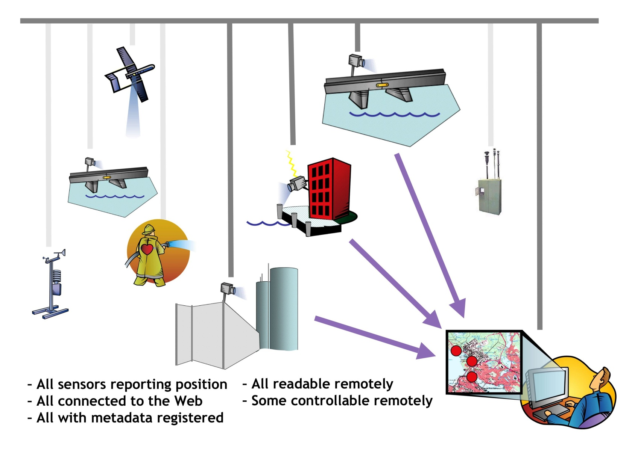
Sensor webs - connecting data
From http://www.sensorsmag.com/networking-communications/wireless-applications/the-big-picture-sensor-webs-disaster-response-demo-1338

Slide 15
OGC, SWE, O&M?
Sensor Web Enablement
OGC – Open Geospatial Consortium
SWE – Sensor Web Enablement initiative
OGC Defined prototyped and tested sensor web components used here:
Sensor Model Language (SensorML)
Observations & Measurements (O&M)
Sensor Observation Service (SOS)
Sensor Model Language
Observations & Measurements
...

Slide 16
INSPIRE directive (ISO 19115)
The INSPIRE directive came into force on 15 May 2007 and will be implemented in various stages, with full implementation required by 2019.
The INSPIRE directive aims to create a European Union (EU) spatial data infrastructure. This will enable the sharing of environmental spatial information among public sector organisations and better facilitate public access to spatial information across Europe.
Adopting OGC SensorML/O&M enables INSPIRE compliance.

Slide 17
Linked data/semantic web
Describe a recommended best practice for exposing, sharing, and connecting pieces of data, information, and knowledge on the Semantic Web using URIs and RDF.
Semantic Web technologies provide an environment where applications can aggregate and query that data, draw inferences using controlled vocabularies
Data needs to be available in a standard format (RDF, SPARQL endpoints) in order to be interconnected as Linked Data.

Slide 18
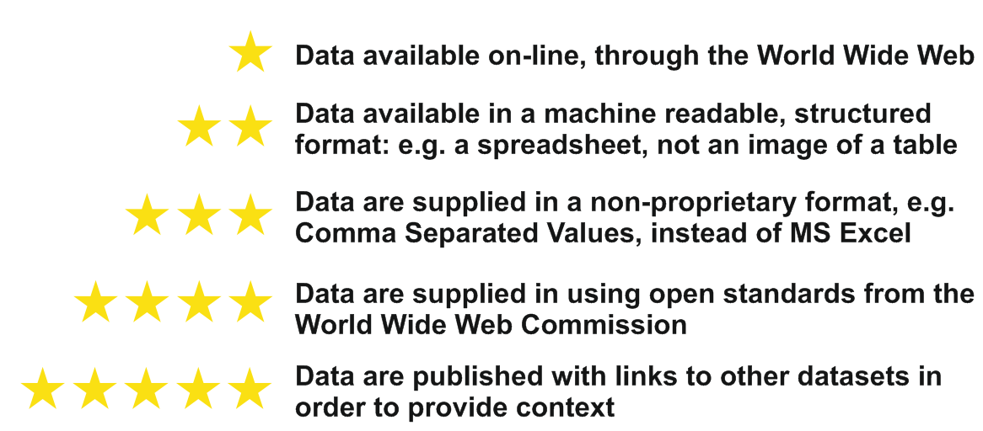
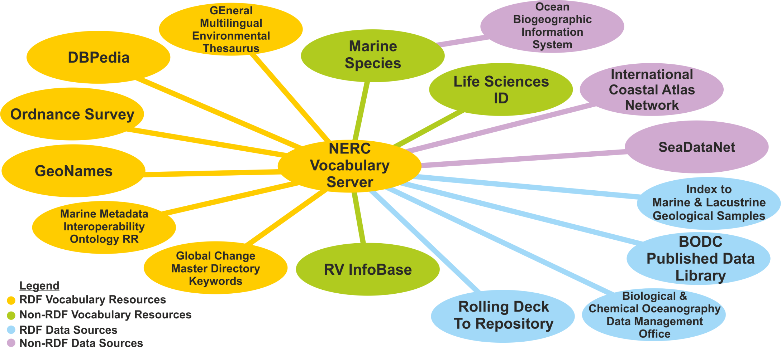
NERC vocabulary server linkages

Slide 19
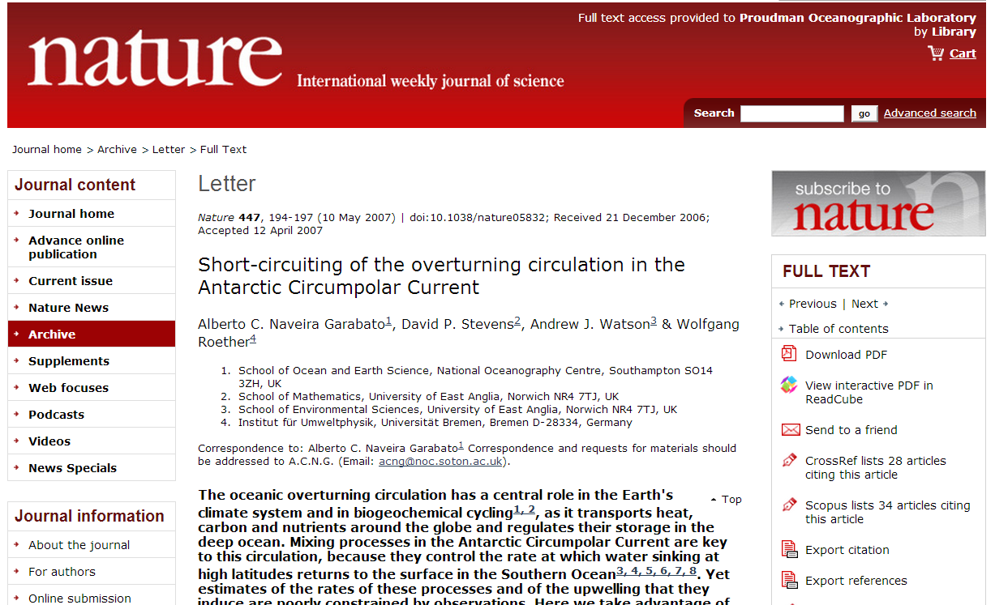
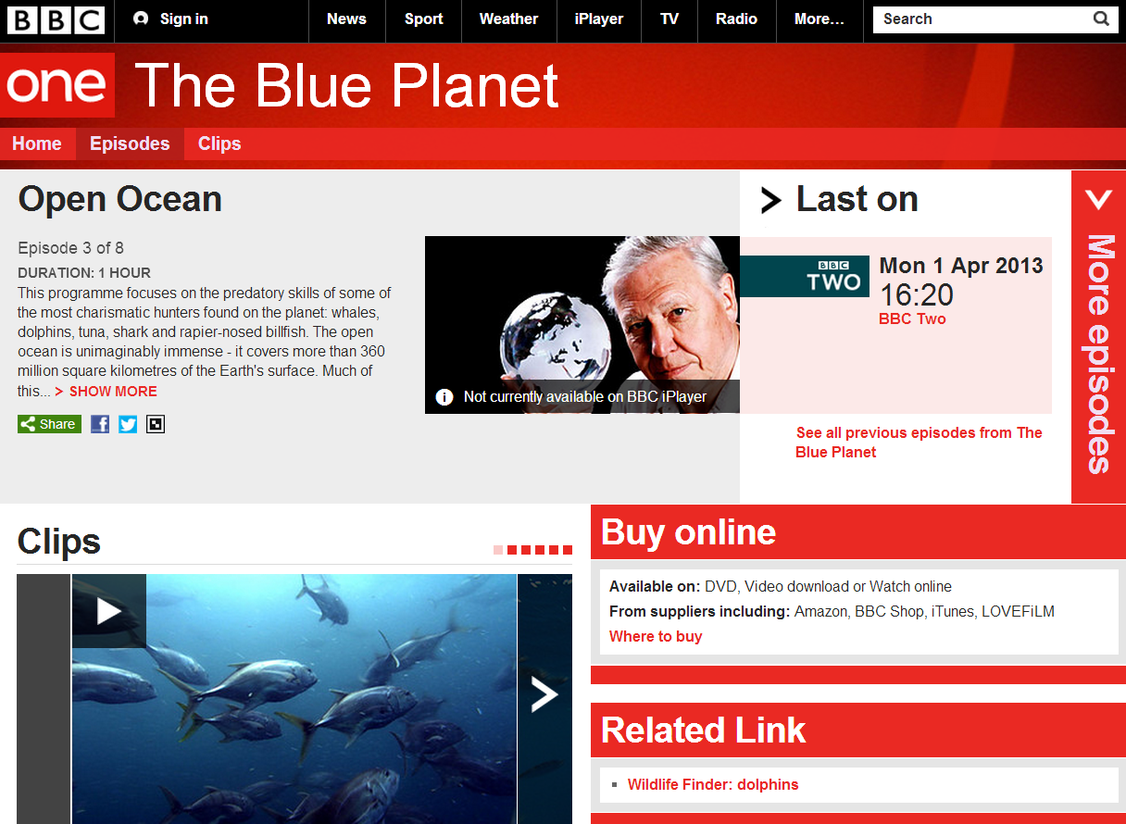
In the context of a dataset

Slide 21
Examples
Early version of BODC linked data: http://linked.bodc.ac.uk/
Example query:
SELECT ?x ?y ?z
WHERE {
<http://linked.bodc.ac.uk/series/910944> ?y ?z .
}
For a non-oceanographic domain example see BBC things:
http://www.bbc.co.uk/things

Slide 22
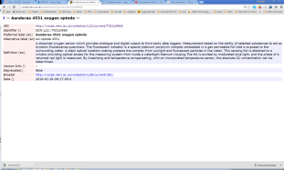
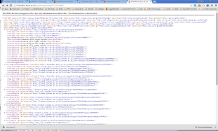
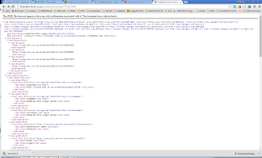
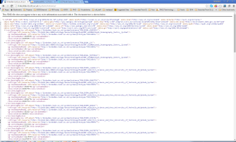
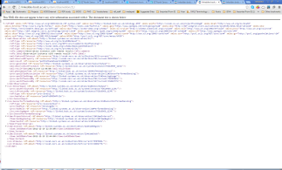
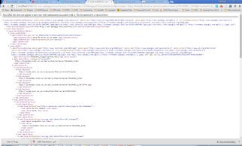
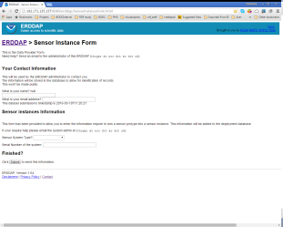
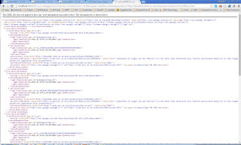
WEB
NVS2
RDF/HTML
Sensor Models
L22
SKOS
PURL agent
RDF
SSN
SensorML
SenseOcean
DB
RDF
SSN
52North
SOS Access Point
DescribeSensor
instance
RDF
GetObservation
Sensor Instances
observation
Access Control
ERDDAP
instance
File Store
UUID
UUID
UUID
observation
UUID

Slide 23
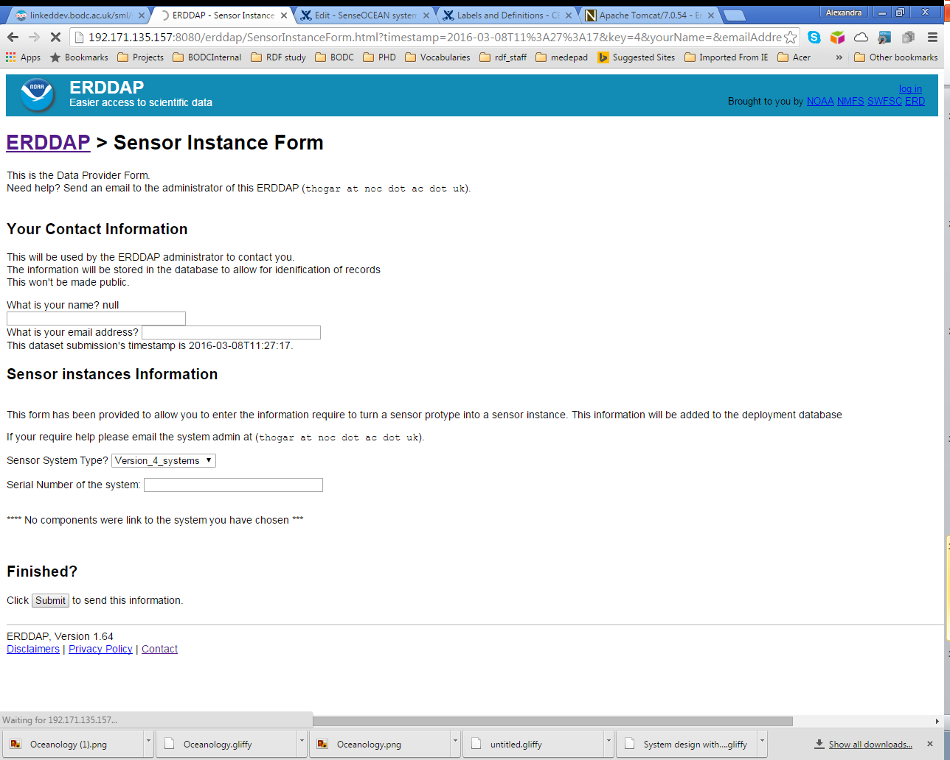

Slide 24
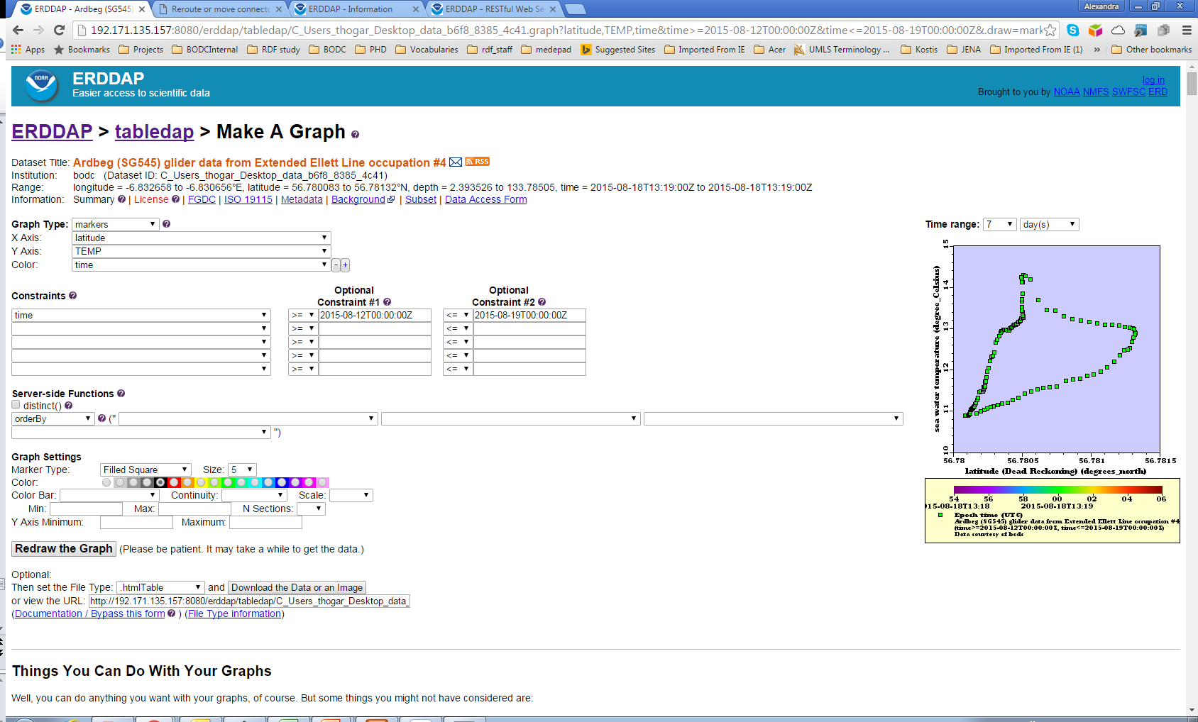

Slide 25
Summary
OGC and Linked Data tools going into production
OGC SensorML/O&M
INSPIRE compliance (ISO 19115)
Aligned with on-going EU projects and ‘Marine SWE profiles’ group. SOS services to broker data in AltantOS.
Efficiencies in data ingestion, processing and sharing
Linked data
SPARQL endpoint enables complete metadata search
Enables the linking of data beyond the oceanographic domain
Opens data up to a new communities of users e.g. ‘big data’

Slide 26
One last thought on data discovery from a recent discussion with a colleague…
“I was asking [data scientists] how they discover their data and they all answered”
Is next goal to ensure data standardisation and exposure maximises discoverability via Google et al.?

